Slide 1
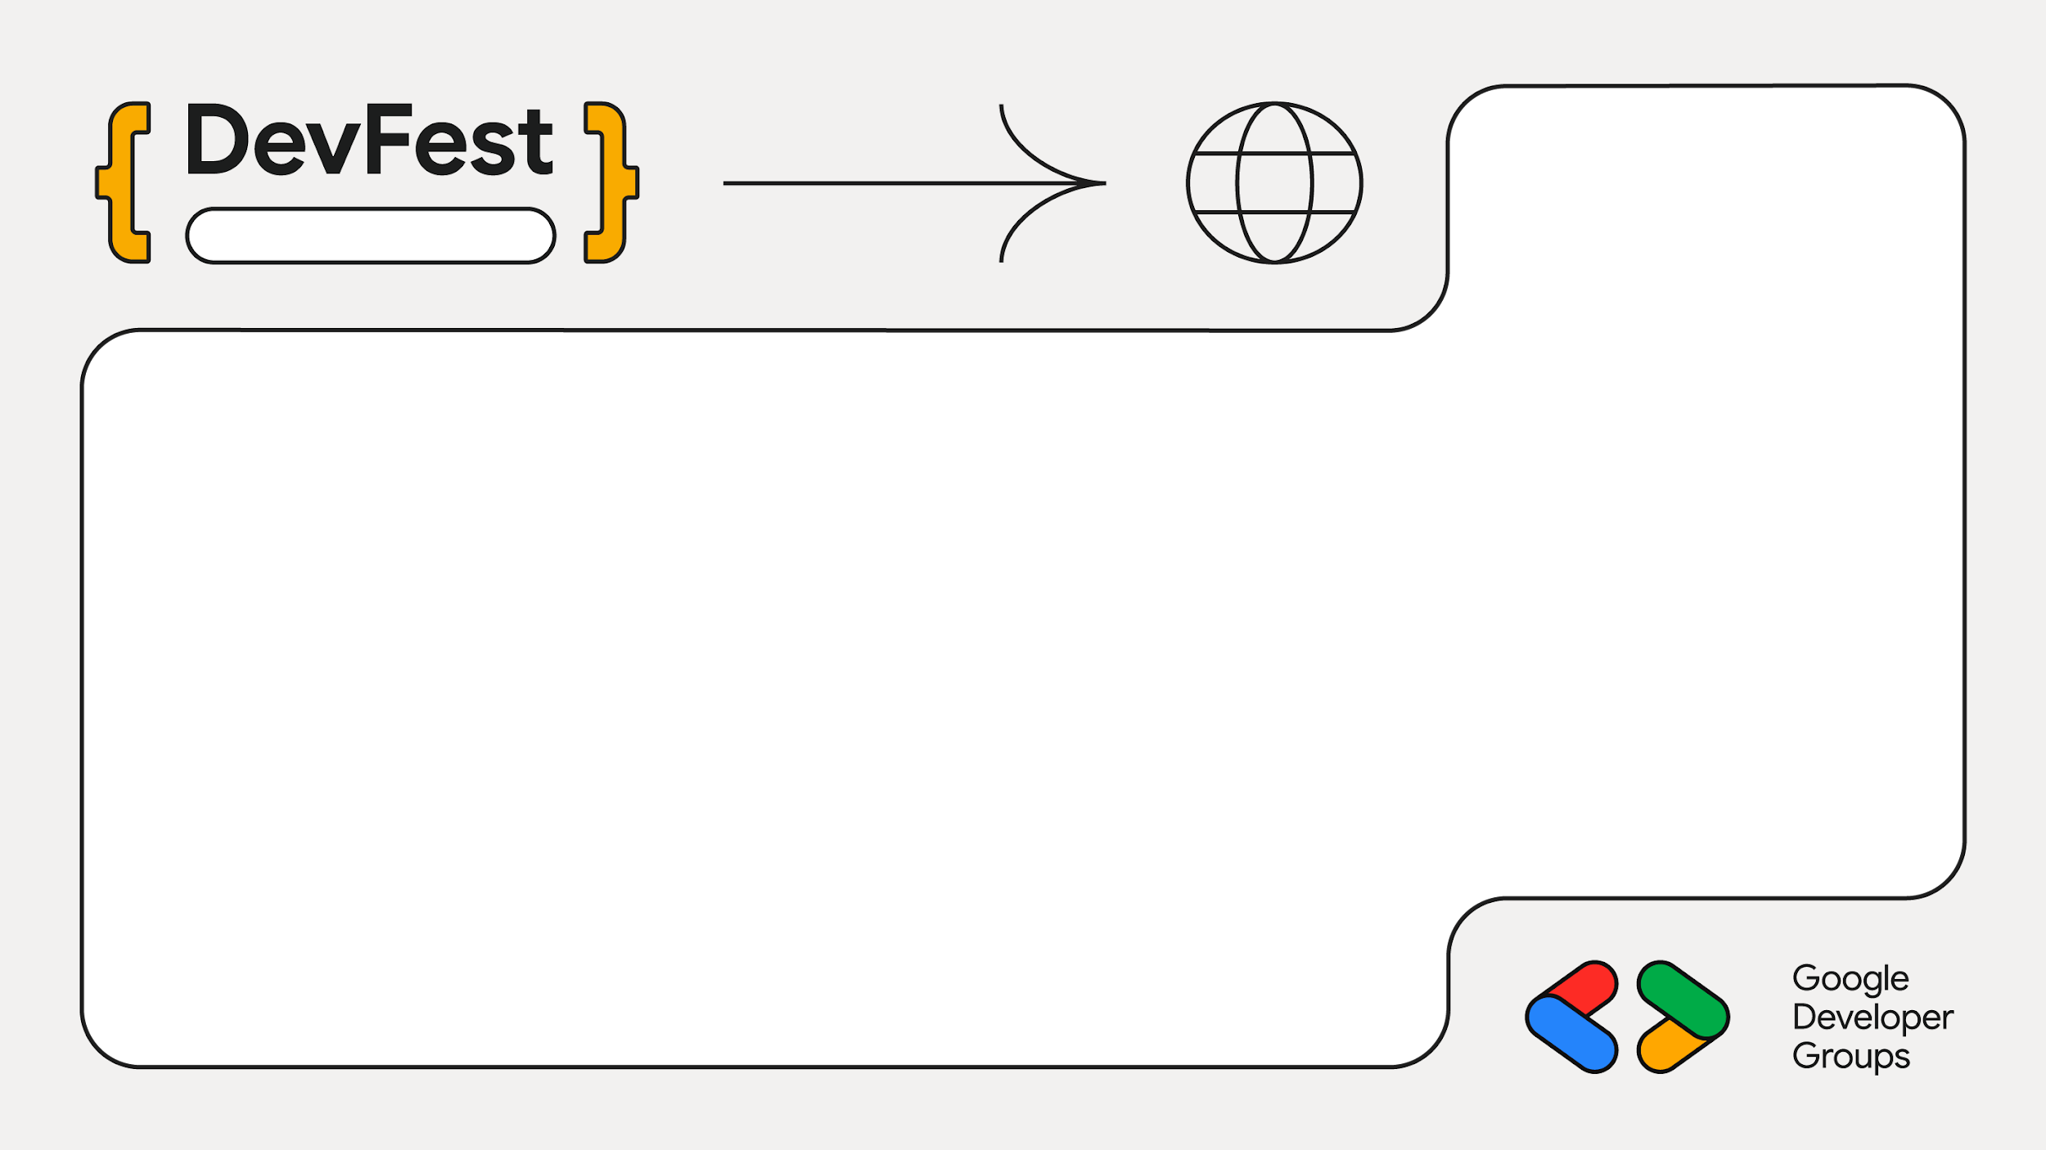
2025
Sarit
Building Technology for Social Impact
Oliver Wainaina
Winnie Mandela

Slide 2
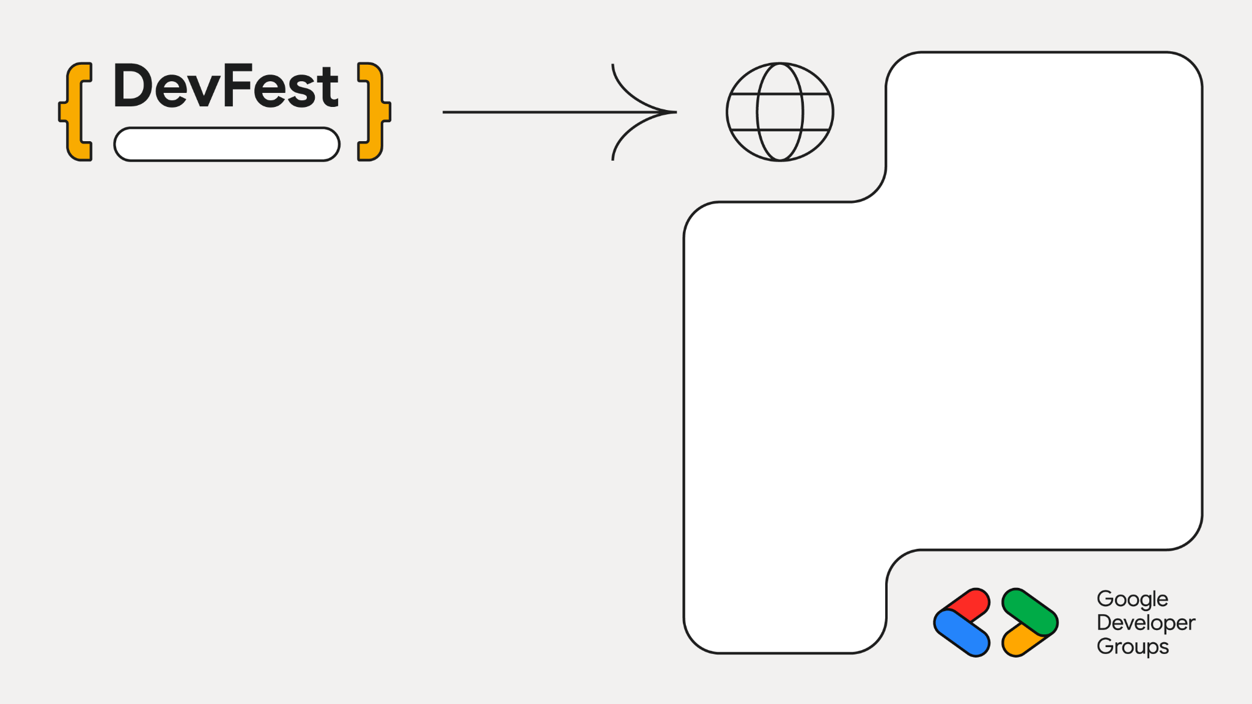

Sarit
Mandela - The Learner
Winnie Mandela
Product Associate,Amref Health Africa

Slide 3

Sarit
Curious Beginner to Founder
Oliver Wainaina
Tech Lead,Tusonge

Slide 4
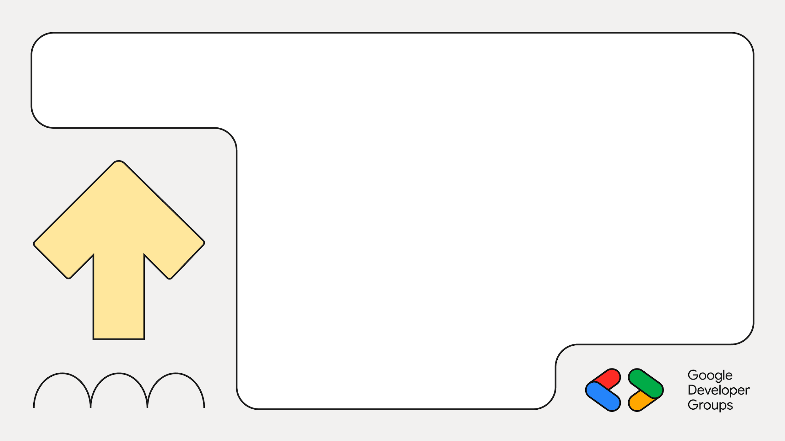
02
The Problem: Pain Is the Currency
Who are the Vulnerable?
Case Study:
Witnessing abuse and listening to stories of abuse.

Slide 5

44%
More than
Of Kenyan women experience abuse at one point in their lives

Slide 6
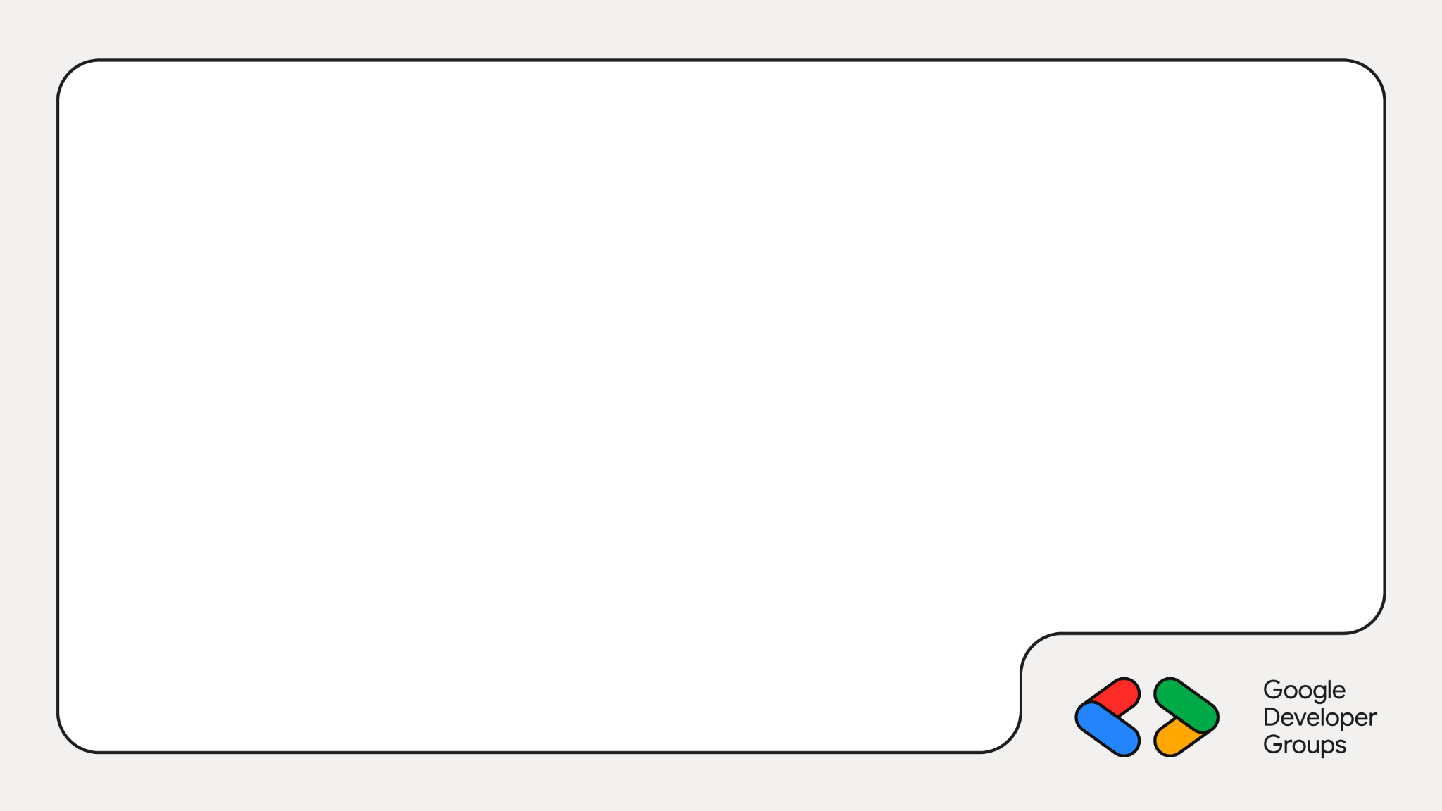
The Reporting Barrier:
Why the statistics are low
Stigma: Not a problem for the marginalized alone; wealthy and men suffer in silence too.
High Cost: Loss of credibility for professionals (the ultimate vulnerability).

Slide 7
03
Flaw in Digital-First Thinking
How many of us have kenyan apps made by other people (not safaricom / mpesa)?

Slide 8

Sarit Centre
The Pre-Scale Rule: First, we must build a personal, face-to-face (F2F) solution (trust), and then build software to automate and scale.

Slide 9

Introducing…

Slide 10
03
Designing from First Principles:
Building With, Not For

Slide 11

Sarit Centre
The Principle: "If I am not in the room and the solution is meant for me, then the solution is against me."

Slide 12
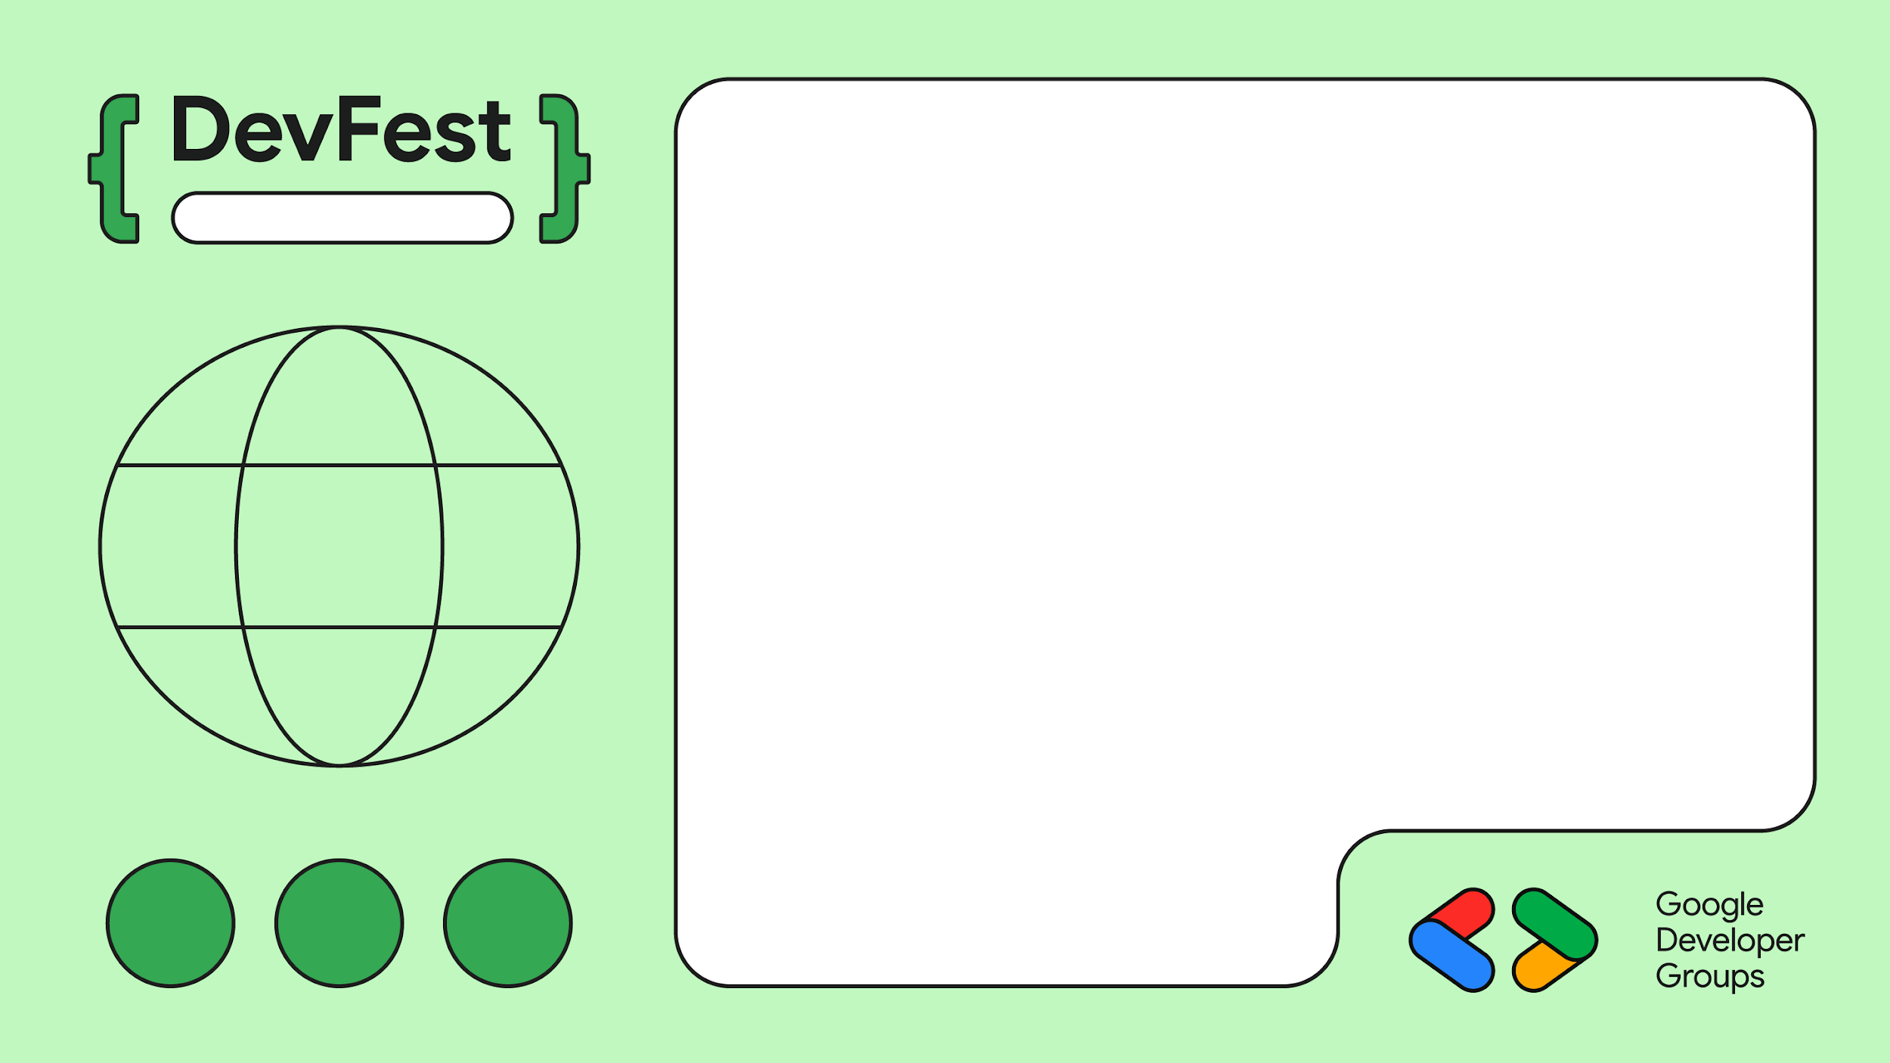
Sarit Centre
Empathy Mapping
Building with Privacy in mind (not just a legal clause). The solution must not compound builders' pain points only.

Slide 13

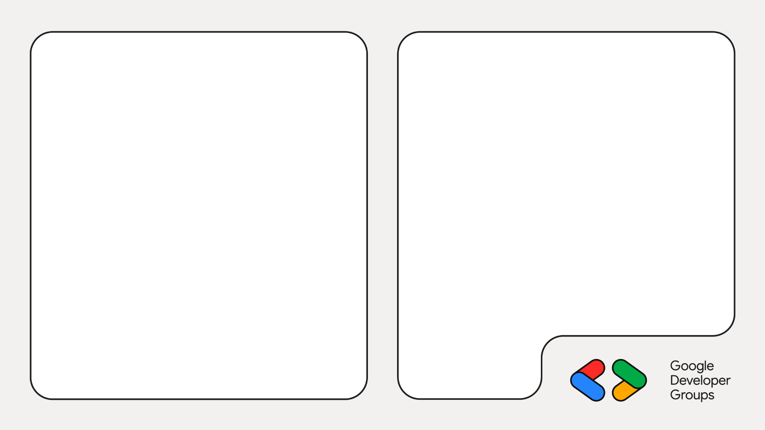
Survivors Cafe sessions were used to get feedback from survivors
Providing a safe space for survivors

Slide 14
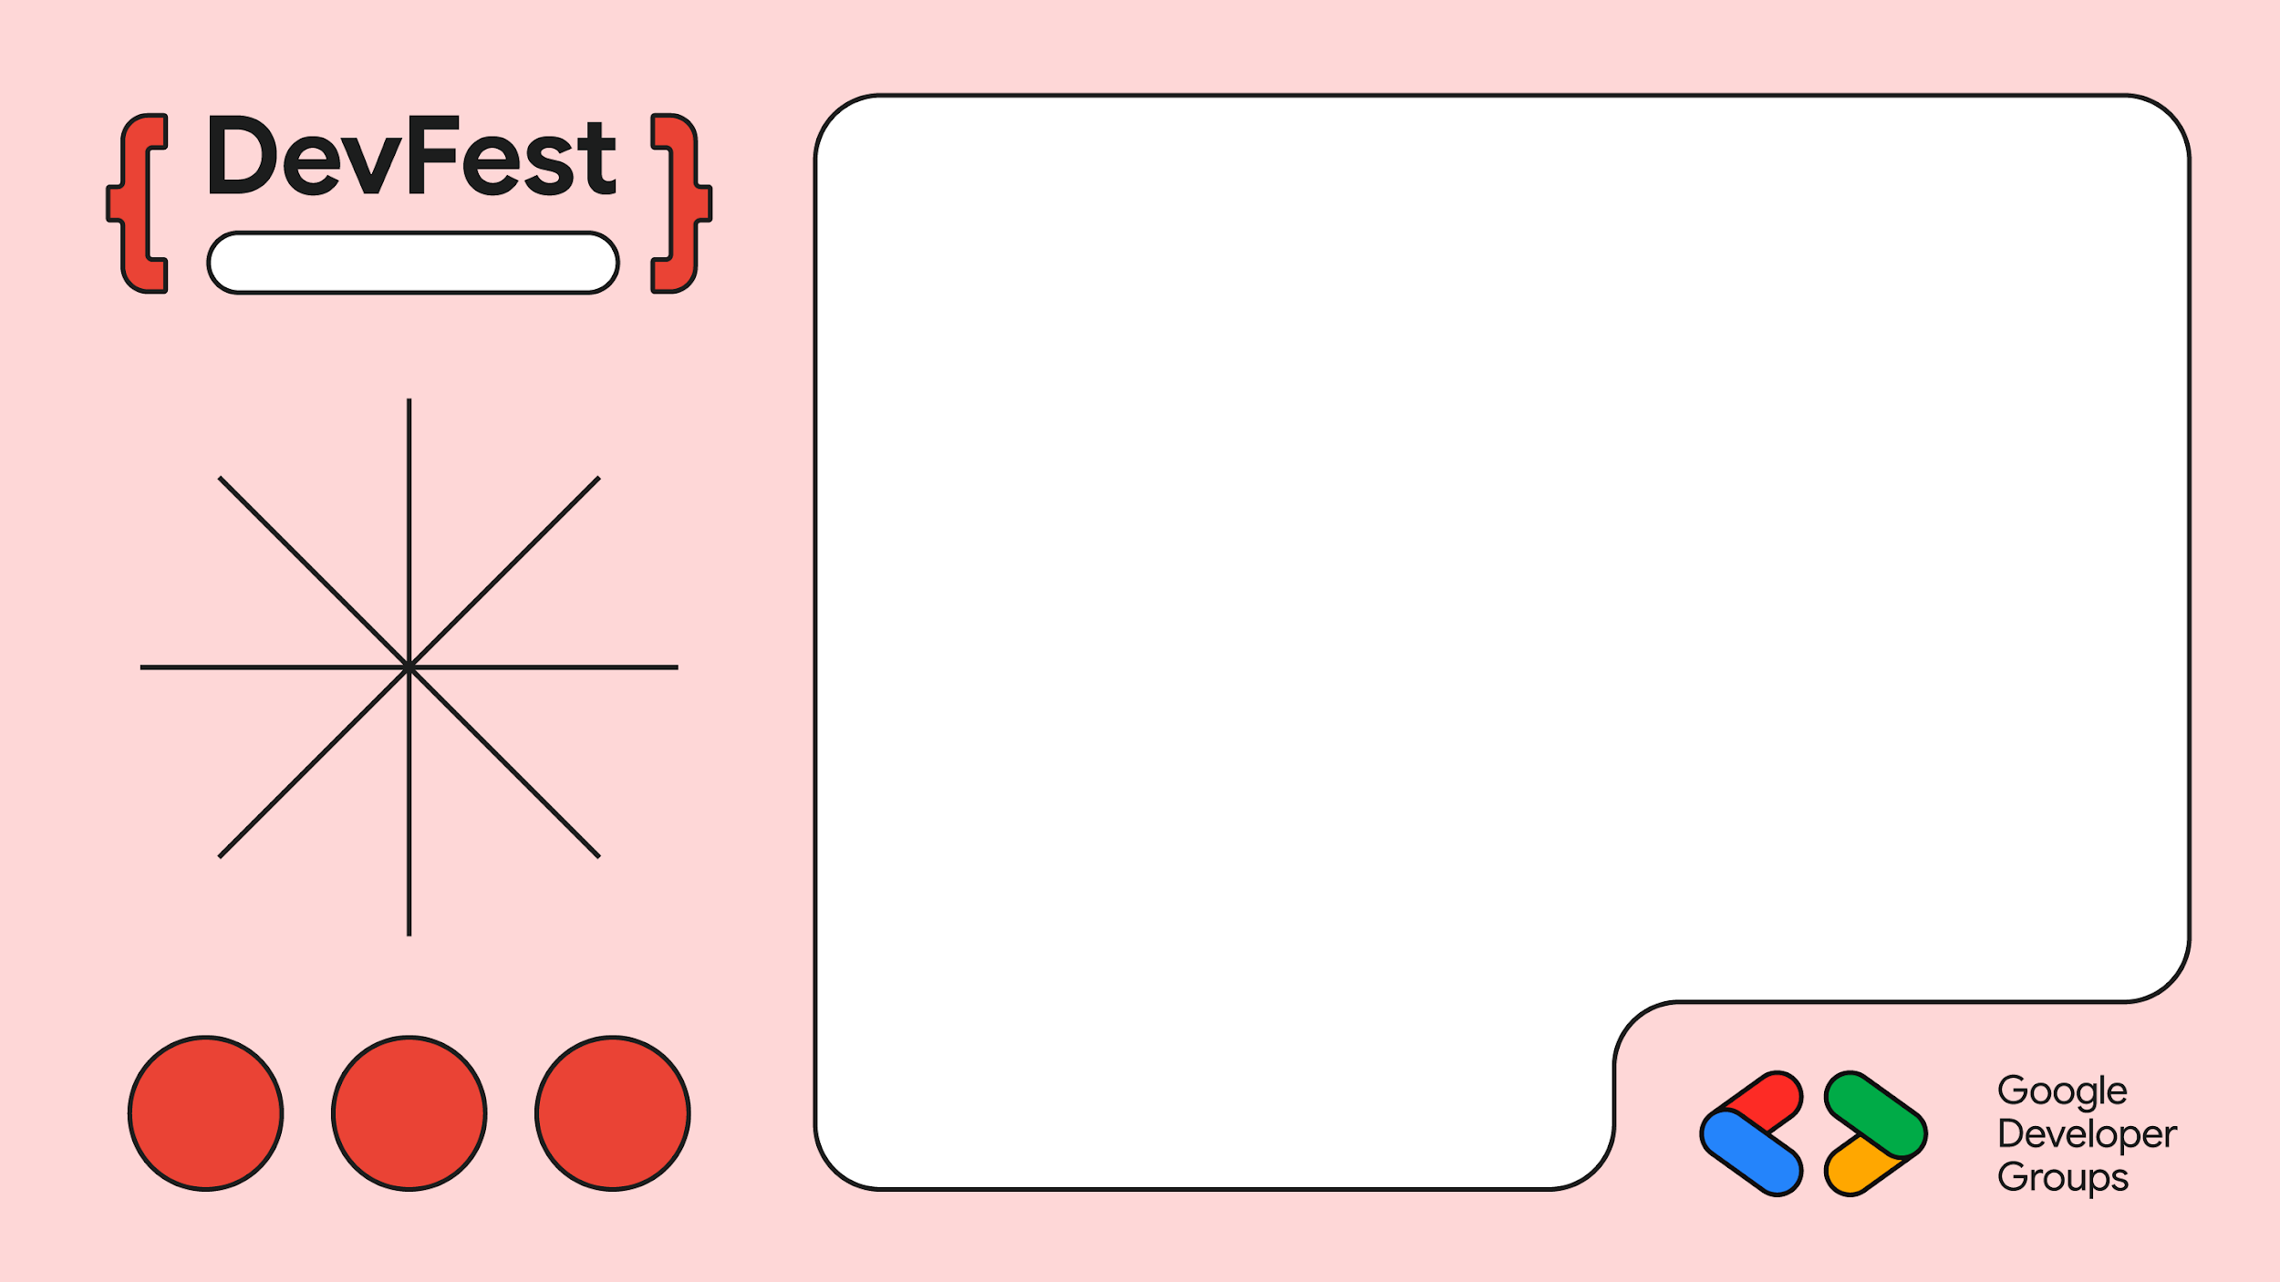
Sarice Centre
Empathy Mapping
Flutter App
Web App

Slide 15
04
Building a Safe Digital Haven on the Cloud
Google Cloud Platform (GCP) and Firebase for reliability and scalability.

Slide 16

Rapid Prototyping: Using Gemini and Firebase studio for quick prototypes and MVPs
Firebase Studio
https://firebase.studio/

Slide 17
Features of Sauti Salama
Reporting a case of Abuse
Anonymous reporting where you get anonymous help
Reporting with your actual details
Matching of Reported case with Profesional
Legal, Mental Health, Emergency Shelter
Community and Resources
Connect, Learn and share

Slide 18
Survivor Impact:
Over 400 cases reported and connected to critical legal, medical, and psychosocial support.
More cases reported through the app than face to face / via call.
Global Recognition:
Participation in COP28, COP29, and COP30
Policy making:
Kictanet

Slide 19
Reporting Flow with different Stakeholders
Case Reporting
Survivor
admin(Sauti Salama)
Professional(Sheltering Home)
Anonymous report
Anonymous helping

Slide 20
Anonymous Reporting
Survivor
Hosting
Firestore
Cloud functions
Cloud funtions
Open Website
Click Report
Fill Form
Temp Account created
Matching
Want to share contact
Contact details shared
Gets Anonymous Help
Yes
Gets Anonymous Help
End
No

Slide 21
Professionals
Professional
Open Website
See matched cases
Can Help
Contact survivor
Yes
Survivors case sent back for matching with other professionals
No

Slide 22
05
Demo on Firestore
Redesigning anonymous Reporting

Slide 23
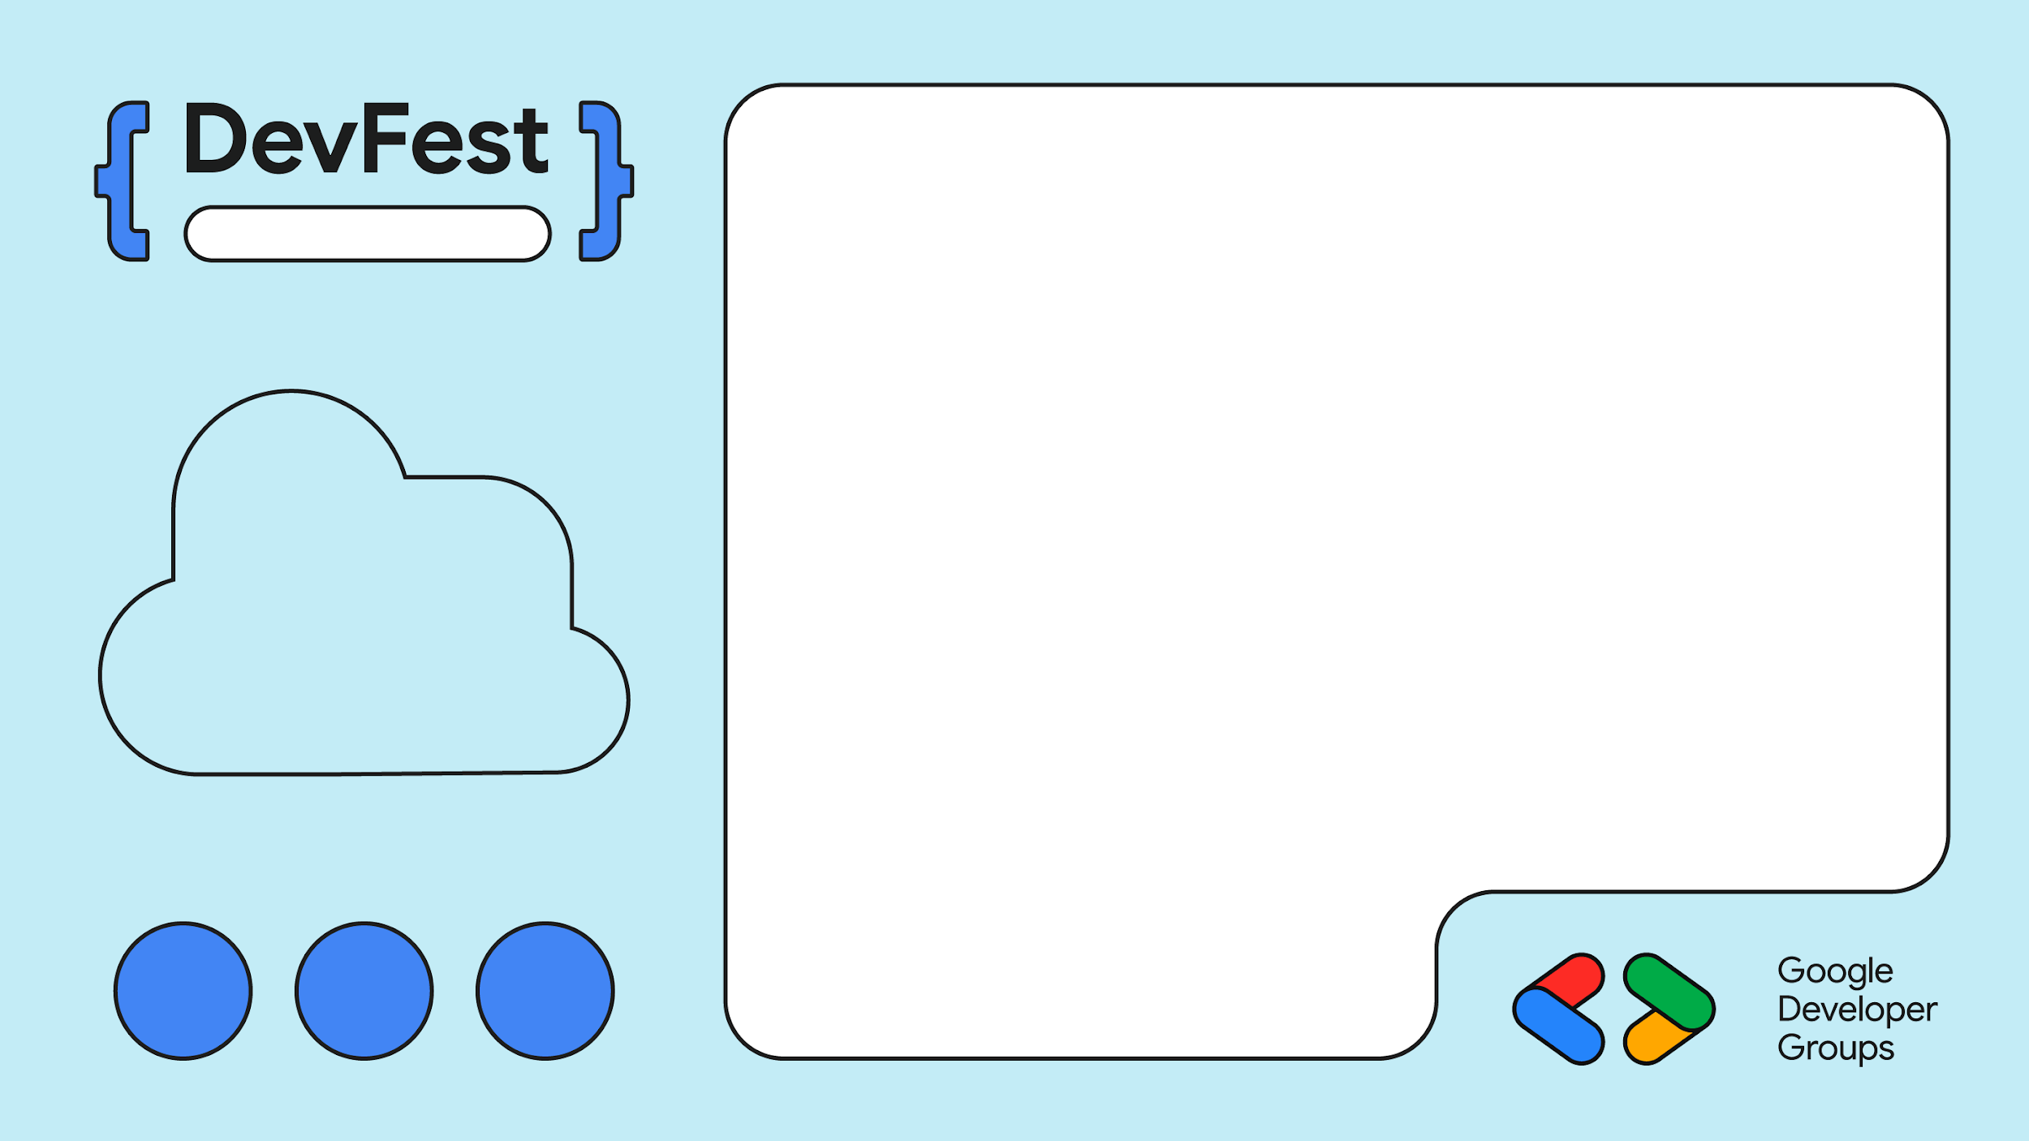
Sarit Centre
Prerequisites
Basic Firebase knowledge
Check out Firebase Kenya
Google Cloud

Slide 24
Sarit Centre
bit.ly/ssdevfest

Slide 25
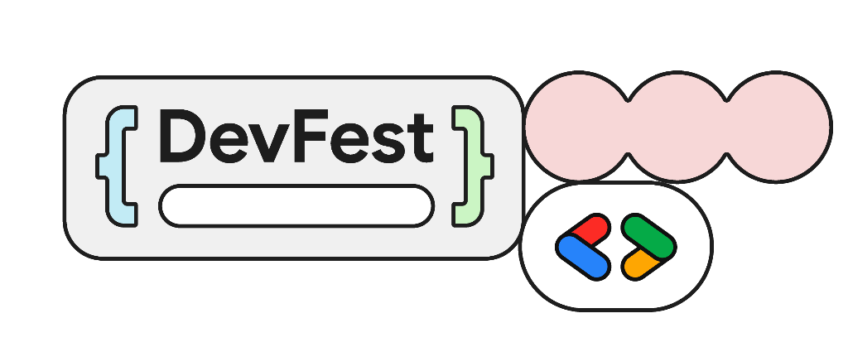
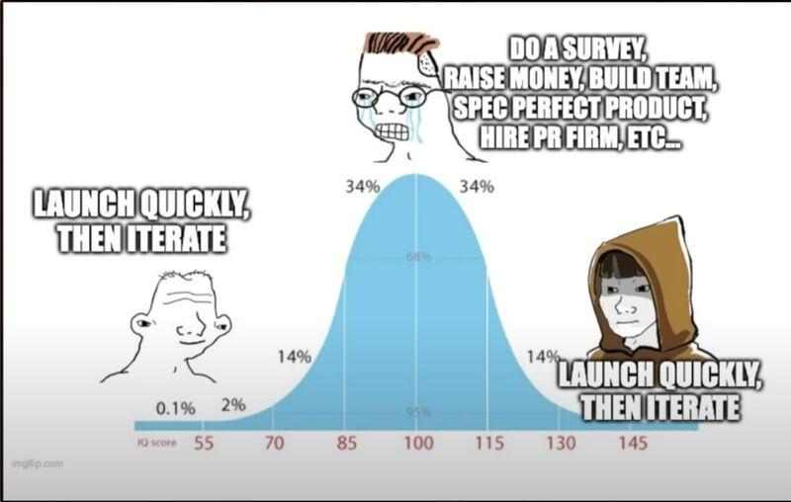
Sarice Centre
Ship, Learn, Iterate.
Oliver Wainaina
oliverwainaina.co.ke
https://media.licdn.com/dms/image/v2/D4D22AQG-cskDlGgXWQ/feedshare-shrink_800/feedshare-shrink_800/0/1691873374730?e=2147483647&v=beta&t=7niBISteSM3B09qQ9A9cMp7ERLnogdLSZzIWXZbIxvw

